Slide 1


HOUSE PRICES
PREDICTION
This Photo by Unknown Author is licensed under CC BY-SA-NC

Slide 2

Problem statement :
Ask a home buyer to describe their dream house, and they probably won't begin with the height of the basement ceiling or the proximity to an east-west railroad. But this playground competition's dataset proves that much more influences price negotiations than the number of bedrooms or a white-picket fence.
With 79 explanatory variables describing (almost) every aspect of residential homes in Ames, Iowa, this competition challenges you to predict the final price of each home.
SOURCE - KAGGLE

Slide 3
APPROACH
Advanced
Regression
Techniques
Random Forest
Gradient
Boosting

Slide 4
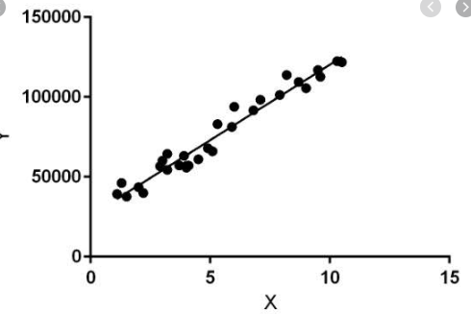
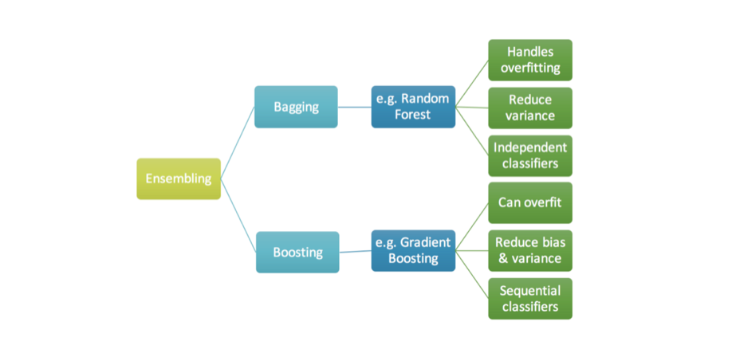
LINEAR REGRESSION - Linear regression quantifies the relationship between one or more predictor variables and one outcome variable. Linear regression is used for predictive analysis and modeling.
Random forest -
A large number of relatively uncorrelated models operating as a
committee will outperform any of
the individual constituent models
GRADIENT BOOSTING -
GRADIENT BOOSTING LEARNS FROM THE MISTAKE – RESIDUAL ERROR DIRECTLY , RATHER THAN UPDATE THE WEIGHTS OF THE DATA POINTS

Slide 5
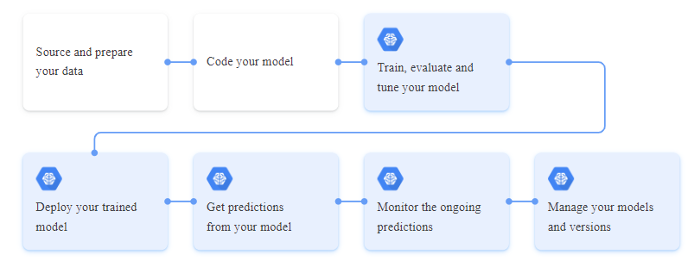
Obtain
Data
Frame The
Problem
Analyze
Data
Feature
Engineering
Data
Cleaning
Model Selection
Predict
The
Model
Tune
The
Model
IMPLEMENTATION
PROCESSING
STEPS

Slide 6
Steps
Import The Required libraries
Reading The CSV File
Checking The Data Set Information Using The info() Command- Train.info()
Displaying The Columns That Are NULL
Visualizing Null Values By Plotting Missing Value Attributes Using HEATMAP
Visualizing Top 50% Correlation Train Attributes With The Sale Price
Printing The Most Important Features Relative To Target
Computing Missing Values And Dropping Attributes
Checking For any missing Values Using HEATMAP
Encoding String To Integer Using Label Encoder
Preparing Data For Prediction By Splitting The Data Into Train-Test Format
Predicting Sale Price Using Linear Regression ,Random Forest And Gradient Boosting And Finally Submitting The Result

Slide 7
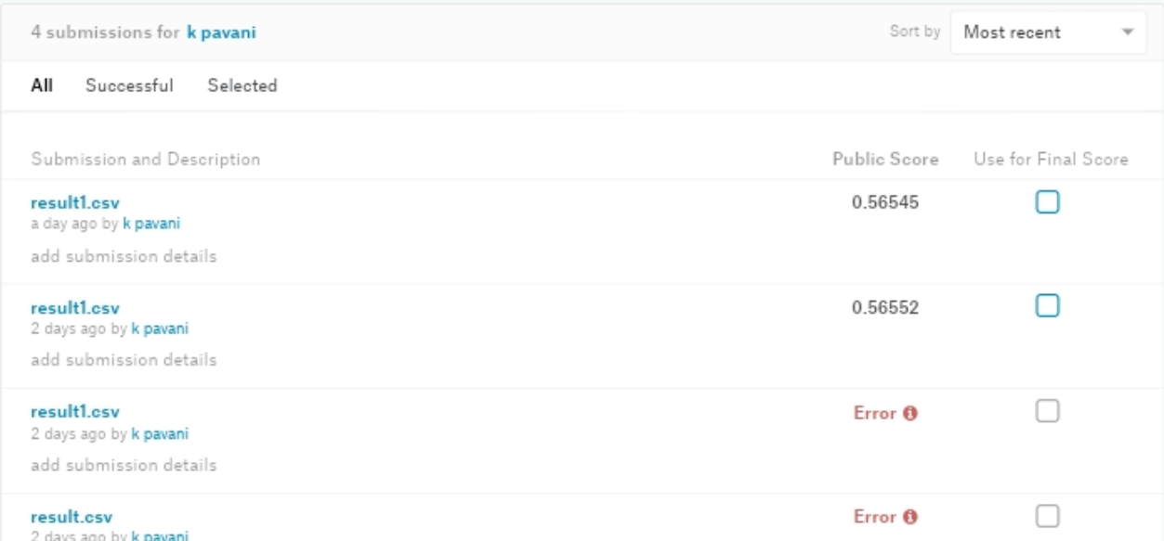
PREDICTION SCORE

Slide 8



THANK YOU
ANY QUESTIONS ??

